Slide 1

Fundamentals of IT
BIT-01 BBA-Ist year MMMUT, Gorakhpur
A
PDF on UNIT-2
Data & Information

Slide 2
Data & Information
Data is any collection of numbers, characters or other symbols that has been coded into a format that can be input into a computer and processed.
Data on its own has no meaning, or context.
It is only after processing by a computer that data takes on a context and becomes information.
Information is a data put into context. Information is utilised by humans in some significant way. A good example of information would be a computer. A computer uses programming scripts, formulas, or software applications to turn data into information.

Slide 3
Data
Data can be defined as a representation of facts, concepts, or instructions in a formalized manner, which should be suitable for communication, interpretation, or processing by human or electronic machine.
Data is represented with the help of characters such as alphabets (A-Z, a-z), digits (0-9) or special characters (+,-,/,*,<,>,= etc.)
What is Information?

Slide 4
Information
Information is organized or classified data, which has some meaningful values for the receiver. Information is the processed data on which decisions and actions are based.
For the decision to be meaningful, the processed data must qualify for the following characteristics −
Timely − Information should be available when required.
Accuracy − Information should be accurate.
Completeness − Information should be complete.

Slide 5
Digital representation of Information
The data representations used in modern computer systems all fall into this family. Their fundamental property is they represent information indirectly: physical phenomena are used to represent sequences of binary digits (zero or one), and sequences of binary digits are then interpreted as integers, real numbers, characters, or other “primitive” data types.
The fundamental property of digital representations is that they are based on the use of a finite number of discrete symbols to represent information.

Slide 6
Digital representation of Information
Finite systems can represent only a finite number of symbols, in any such system there is only a finite number of possible meaningful states; this is a fundamental difference between digital and analog representations of information.
In digital systems, the physical similarity of two representations of information is no guide to the similarity of the information they represent. (For example, the bit sequences 0000 0000 and 1000 0000 differ only in the value of a single bit, but if they are taken as unsigned integers, they denote 0 and 128; many numbers much closer to zero than 128 have representations very different from either.)

Slide 7
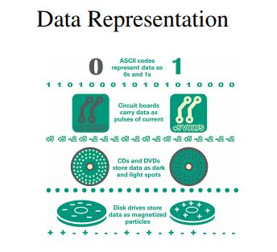
Data Representation
• The 0s and 1s used to represent digital data are referred to as binary digits — from this term we get the word bit that stands for binary digit. • A digital file, usually referred to simply as a file, is a named collection of data that exits on a storage medium, such as a hard disk, CD, DVD, or flash drive.

Slide 8
Text Representation
What is ASCII
ASCII stands for American Standard Code for Information Interchange. It is an encoding standard that represents digits, letters, and symbols using numbers.
The digits can be 1, 2, 3, etc. while the letters are a, b, c, A, B, C, etc. The symbols are characters like !, $, and #.
Therefore, it is possible to convert any piece of text to the corresponding set of numbers using ASCII. This conversion makes it easier to store them in the computer memory.

Slide 9
ASCII uses 7 bits to represent a character. It represents a maximum of 128 (2⁷) characters.
ASCII is mainly used in programming, data conversions, graphic arts and text files. However, one issue in ASCII is that it can only represent 128 characters. It does not have representations for letters in other languages such as Greek and Arabic or mathematical symbols. There is a new version of ASCII called Extended ASCII. It includes the standard ASCII characters with additional characters.

Slide 10
Letter | ASCII Code | Binary | Letter | ASCII Code | Binary
a | 097 | 01100001 | A | 065 | 01000001
b | 098 | 01100010 | B | 066 | 01000010
c | 099 | 01100011 | C | 067 | 01000011
d | 100 | 01100100 | D | 068 | 01000100
e | 101 | 01100101 | E | 069 | 01000101
f | 102 | 01100110 | F | 070 | 01000110
g | 103 | 01100111 | G | 071 | 01000111
h | 104 | 01101000 | H | 072 | 01001000
i | 105 | 01101001 | I | 073 | 01001001
j | 106 | 01101010 | J | 074 | 01001010
k | 107 | 01101011 | K | 075 | 01001011
l | 108 | 01101100 | L | 076 | 01001100
m | 109 | 01101101 | M | 077 | 01001101
n | 110 | 01101110 | N | 078 | 01001110
o | 111 | 01101111 | O | 079 | 01001111
p | 112 | 01110000 | P | 080 | 01010000
q | 113 | 01110001 | Q | 081 | 01010001
r | 114 | 01110010 | R | 082 | 01010010
s | 115 | 01110011 | S | 083 | 01010011
t | 116 | 01110100 | T | 084 | 01010100
u | 117 | 01110101 | U | 085 | 01010101
v | 118 | 01110110 | V | 086 | 01010110
w | 119 | 01110111 | W | 087 | 01010111
x | 120 | 01111000 | X | 088 | 01011000
y | 121 | 01111001 | Y | 089 | 01011001
z | 122 | 01111010 | Z | 090 | 01011010

Slide 11
What is EBCDIC
EBCDIC stands for Extended Binary Coded Decimal Interchange Code. It is mainly used on IBM mainframe and IBM midrange computer operating systems. It is also supported by some platforms other than IBM. EBCDIC uses 8 bits to represent a single character, and it represents a 256 (28) alphanumeric and special characters.
There are several disadvantages to EBCDIC. When compared to ASCII, the same character which takes 7 bits to represent in ASCII will take 8 bits in EBCDIC. Therefore, EBCDIC is less efficient than ASCII. Moreover, when considering the arrangement of characters, EBCDIC groups 9 characters at a time. Furthermore, it is not compatible with other encodings such as Unicode.

Slide 12
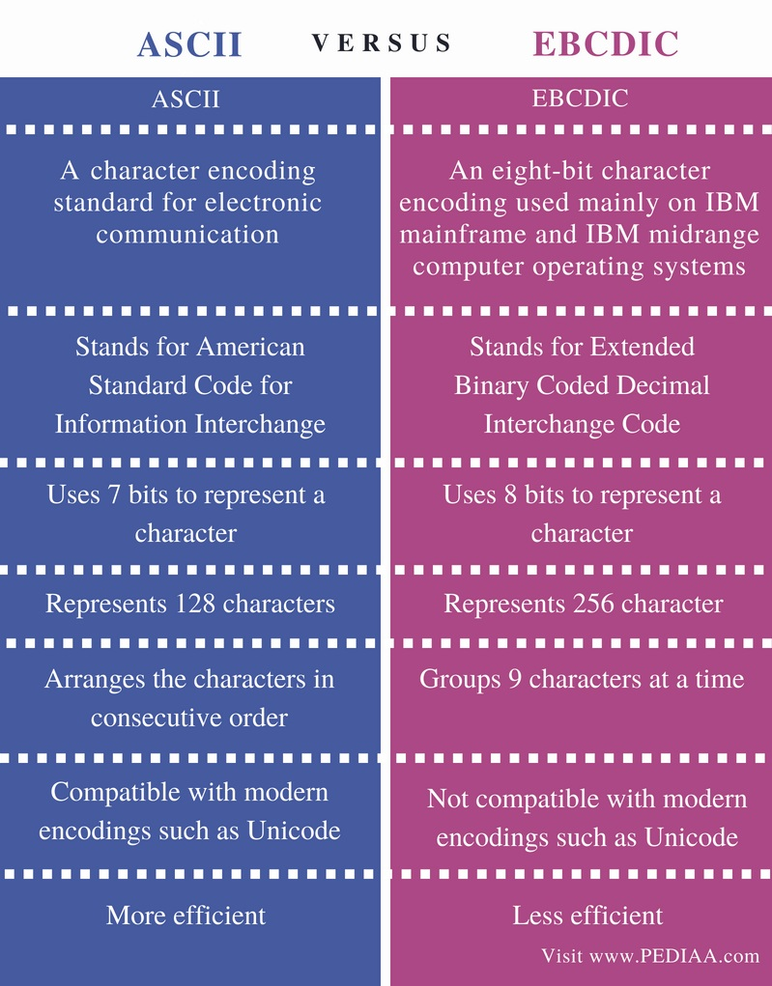
Comparison table

Slide 13
Unicode
Unicode is an international and multilingual text character and coding system
• Unicode uses more bits and therefore can be used for more character combinations
• It was introduced so that lots of different characters from different languages could be easily represented and entered
• It facilitates communication between devices all around the world without relying on translation Unicode

Slide 14
Unicode
• Joe Becker published a draft of Unicode in August 1988. Companies such as Apple and Xerox were involved in its creation
Unicode: (UTF-Unicode Transformation Format)
UTF – 8 = Extended ASCII = 8 Bits
UTF – 16 = Expands to western languages = 16 Bits
UTF – 32 = Most complete character set = 32 Bits

Slide 15
Multimedia
Multimedia in principle means data of more than one medium. It usually refers to data representing multiple types of medium to capture information and experiences related to objects and events.
Commonly used forms of data are numbers, alphanumeric, text, images, audio, and video. In common usage, people refer a data set as multimedia only when time-dependent data such as audio and video are involved.

Slide 16
What is Data Compression?
Data compression shrinks big files into much smaller ones. It does this by getting rid of unnecessary data while retaining the information in the file. Without data compression a 3-minute song would be over 100Mb in size, while a 10-minute video would be over 1Gb in size.
Data compression can be expressed as a decrease in the number of bits required to illustrate data. Compressing data can conserve storage capacity, accelerate file transfer, and minimise costs for hardware storage and network capacity.

Slide 17
Data Compression Methods
There are two kinds of compression: Lossless and Lossy.
Lossy compression loses data, while lossless compression keeps all the data. With lossy compression we get rid of data, which is why we need to distinguish data from information. Lossy compression permanently removes bits of data that are redundant, insignificant or unnoticeable. Lossy compression is suitable with graphics, audio, video and images, where the deletion of some data bits has little or no apparent effect on the illustration of the content. In lossy compression, messages become more efficient by getting rid of unwanted data. Lossy compression lessens the size of the data while retaining more information.
Lossless compression allows the potential for a file to return to its original size, without the loss of a single bit of data, when the file is uncompressed. Lossless compression is the usual approach taken with executables, as well as with text and spreadsheet files, where the loss of words or numbers would change the information. Lossless compression can compress the data whenever redundancy is present. Therefore, lossless compression takes advantage of data redundancy.

